Slide 1
Building Movie Review Website I
Week 08

Slide 2
Objectives
Demonstrate how to build the basic architecture of a web application based on a Movie Review website;
Demonstrate how to build the web pages of a Movie Review website.

Slide 3
Tools Required
Visual Studio Code
Node.js
Browser
Google Chrome (recommended)
Mozilla Firefox

Slide 4
3 Tier Architecture

Slide 5








3 Tier Architecture
Tier 1
Tier 2
Tier 3
Client Tier
(Client’s computer/browser)
Application Tier
(Web Server)
Database Tier
(Database Server)

Slide 6
3 Tier Architecture
Presentation (Client) tier - This tier is built with HTML5, cascading style sheets (CSS) and JavaScript. It is deployed to a computing device through a web browser or a web-based application. The presentation tier communicates with the other tiers through application program interface (API) calls.
Application tier - The application tier, which may also be referred to as the logic tier, is written in a programming language such as Java and contains the business logic that supports the application’s core functions. The underlying application tier can either be hosted on distributed servers in the cloud or on a dedicated in-house server, depending on how much processing power the application requires.
Database tier - The database tier consists of a database and a program for managing read and write access to a database. This tier may also be referred to as the storage tier and can be hosted on-premises or in the cloud. Popular database systems for managing read/write access include MySQL, PostgreSQL, Microsoft SQL Server and MongoDB.

Slide 7
Creating the UI (User Interface)

Slide 8
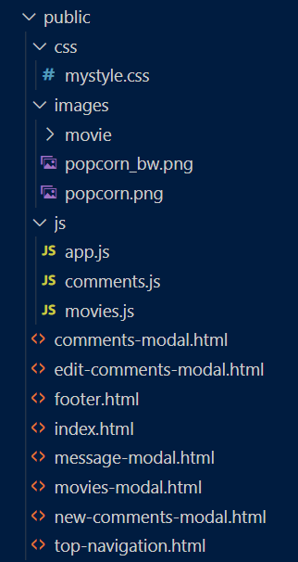
Creating the UI
Watch the demo here
We will begin by creating the UI.
On the right are the files that we need to create for the UI. (All Images will be provided)
Using your movie_review project, create all the folders and files according to the diagram on the right and ask your tutor to validate

Slide 9
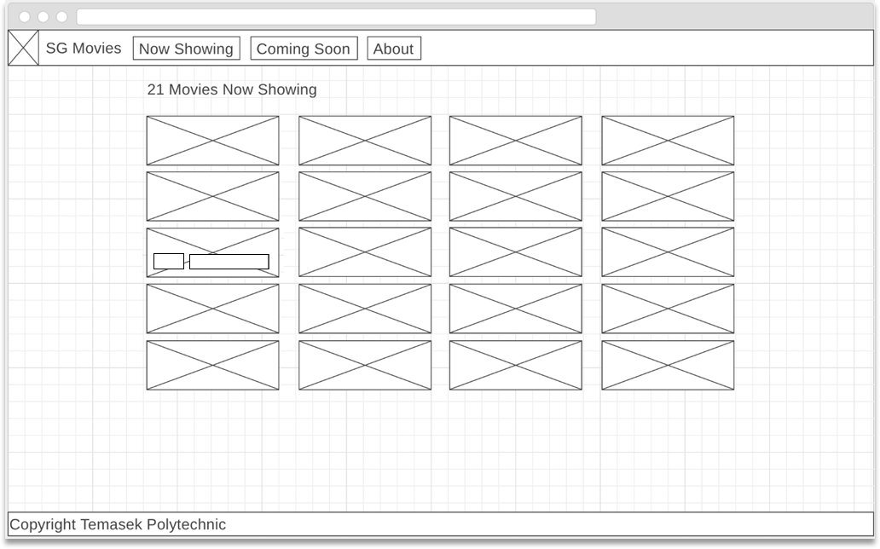
Wireframe
Title
Button or link that displays currently showing movies when clicked.
Button or link that displays coming soon movies when clicked.
Button or link that displays info of website in modal window when clicked.
Navigation Bar
Logo
Heading informing number of movies
Icon to reveal comments for the movies when clicked
Movie title to reveal Movie Description when clicked
Footer
Notes:
https://wireframe.cc/JqpQUx

Slide 10
Creating mystyle.css File
For most of the styling, we will using the stylings from bootstrap
These are the only 2 stylings we will be using. One is for the placement of the edit icon and the other one is for the footer
footer {
background: #aaa;
color: white;
}
.edit {
float: right;
padding-right: 10px;
}

Slide 11
Creating the Home Page (Index.html – The Head)
<!DOCTYPE html>
<html lang="en">
<head>
<title>Movies Review Website</title>
<meta charset="utf-8">
<link rel="stylesheet" href="https://maxcdn.bootstrapcdn.com/bootstrap/4.1.3/css/bootstrap.min.css">
<link rel="stylesheet" href="css/mystyle.css">
</head>
Linking to our own mystyle.css. You can add additional styles here
Using the CDN (content Delivery Network) Bootstrap.css so that we can use their professional css stylings. There are pros and cons for using CDN. One main pro is your website will load faster and one main con is that if the CDN is down, then you will not be able to reference the css

Slide 12
Creating the Home Page (Index.html – the BODY)
This is a javascript event listener. What it means is that after the BODY is rendered by the browser, it will try to look for this function and executes it
<body onload="getMovieData()">
<!-- Include top navigation here -->
<div w3-include-html="top-navigation.html"></div>
<!-- This is the container that holds the initial message, heading, and movies -->
<div class="container">
<!-- The message will be shown when the page loads and will
disappear after the movies are loaded -->
<div class="row" id="parent">
Retrieving movies from database... Please wait...<br><br>
If you are seeing this message for a long time, it is likely
that you have a JavaScript error. Troubleshoot your script by
using the browser console panel now. Please use either Firefox
or Chrome to render this webpage.
</div>
<p>
<!-- This is the heading showing how many movies are there -->
<h3 id="summary"></h3>
</p>
<!-- Displays thumbnails of the movies here -->
<div id="moviesTable" class="row"></div>
</div>
We are using a nifty javascript library to make the whole index.html less clutter. This javascript library will be able to look for a particular html and loads into this <div> during runtime.
These are IDs that we used in order to easily control them using javascript

Slide 13
Creating the Home Page (Index.html – the BODY)
<!-- Include the movies modal here -->
<div w3-include-html="movies-modal.html"></div>
<!-- Include the comments modal here -->
<div w3-include-html="comments-modal.html"></div>
<!-- Include the new comments modal here -->
<div w3-include-html="new-comments-modal.html"></div>
<!-- Include the edit comments modal here -->
<div w3-include-html="edit-comments-modal.html"></div>
<!-- Include the message modal here -->
<div w3-include-html="message-modal.html"></div>
<br><br>
<!-- Include the footer here -->
<div w3-include-html="footer.html"></div>
</body>
These htmls (movies-modal, comments-modal etc ) will be loaded “on the fly” into this index.html when it is being rendered in the browser.
And the reason for using this method is to make the index.html less clutter

Slide 14
Creating the Home Page (Index.html – the SCRIPT TAG)
Here we are using the CDN w3.js
<script src="https://www.w3schools.com/lib/w3.js"></script>
<script>
//to bring in other HTML on the fly into this page
w3.includeHTML();
</script>
<script src="https://ajax.googleapis.com/ajax/libs/jquery/3.3.1/jquery.min.js"></script>
<script src="https://maxcdn.bootstrapcdn.com/bootstrap/4.1.3/js/bootstrap.min.js"></script>
<script src="https://kit.fontawesome.com/86ec7c1143.js" ></script>
<script src="js/app.js"></script>
<script src="js/comments.js"></script>
<script src="js/movies.js"></script>
</html>
The code will start the process of the javascript loading in all the content of the other htmls. Those htmls currently are empty
This is a CDN javascript whereby we can use it to display very nice and professional icons.
Linking to our own javascripts. Currently they are also empty

Slide 15
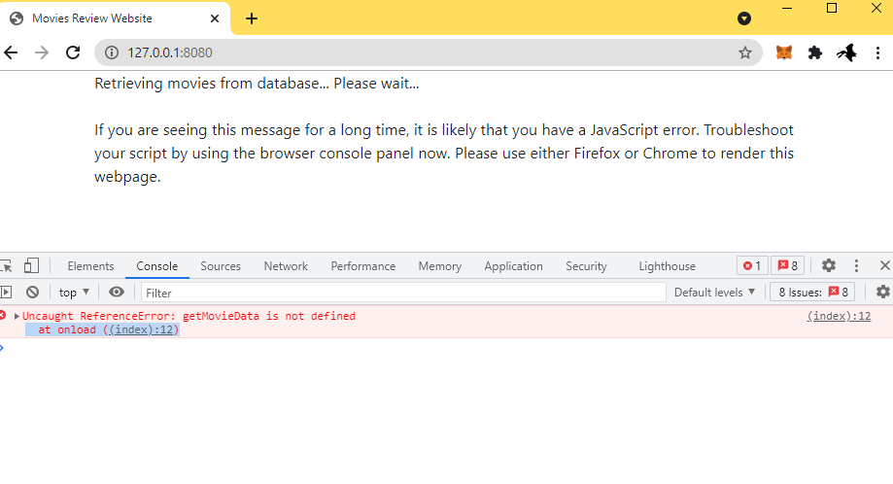
Test Your Homepage
It is paramount to do testing whenever you make some small changes rather than wait till the end. Type localhost:8080 in your browser address bar and you should see this page.
This error is expected as we have not written the getMovieData function yet

Slide 16
Adding footer.html
<footer>
Copyright &copy; Temasek Polytechnic
</footer>

Slide 17
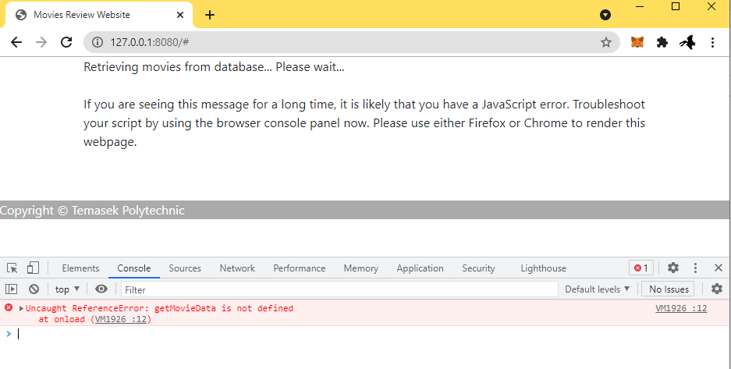
Test the Footer
Reload the index.html page in your browser address bar and you should see the footer appearing below.

Slide 18
Adding Top Navigation – top-navigation.html
<nav class="navbar navbar-expand-md bg-dark navbar-dark">
<a class="navbar-brand" href="#">
<img src="images/popcorn.png" width="30" height="30" class="d-inline-block align-top" alt=""> SG Movies
</a>
<button class="navbar-toggler" type="button" data-toggle="collapse" data-target="#navbarSupportedContent">
<span class="navbar-toggler-icon"></span>
</button>
<div class="collapse navbar-collapse" id="navbarSupportedContent">
<ul class="navbar-nav">
<li class="nav-item active" id="nowMenu">
<a class="nav-link" href="#" id="now" onClick="listNowShowingMovies()">Now Showing</a>
</li>
<li class="nav-item" id="comingMenu">
<a class="nav-link" href="#" id="coming" onClick="listComingMovies()">Coming Soon</a>
</li>
<li class="nav-item" id="aboutMenu">
<a class="nav-link" href="#" id="about" data-toggle="modal" data-target="#messageModal">
About
</a>
</li>
</ul>
</div>
</nav>
This is a standard Navbar in Bootstrap 4. Refer to the official website to customize in the manner you desire

Slide 19
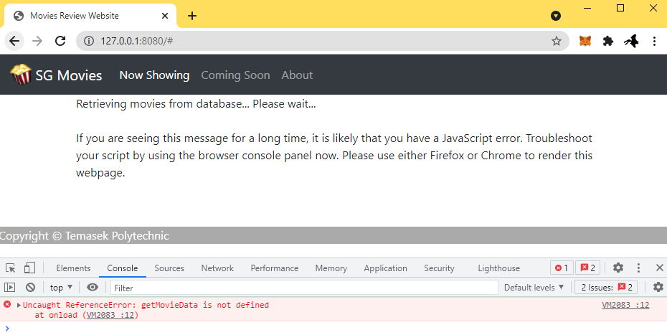
Test the Top Navigation
Reload the index.html page in your browser address bar and you should see the top navigation appearing at the top. Each of the links does not do anything yet and in fact will generate a javascript error as it cannot find the javascript function to execute

Slide 20
Adding “About” Modal Window – message-modal.html
<!-- this is a structure of Bootstrap Modal -->
<div class="modal fade " id="messageModal" tabindex="-1" role="dialog">
<div class="modal-dialog modal-sm " role="document">
<div class="modal-content">
<div class="modal-body px-5">
<span id="message">This is an academic website teaching students on fundamentals of various web technologies such as CSS, HTML, Javascript and Restful Web APIs<br><br>Please use Firefox or Chrome</span>
<div class="modal-footer">
<button type="button" class="btn btn-secondary bg-dark" data-dismiss="modal" style="float: none; margin: 0 auto;">Close</button>
</div>
</div>
</div>
</div>
</div>
This is a standard Modal in Bootstrap 4. Refer to the official website to customize in the manner you desire

Slide 21
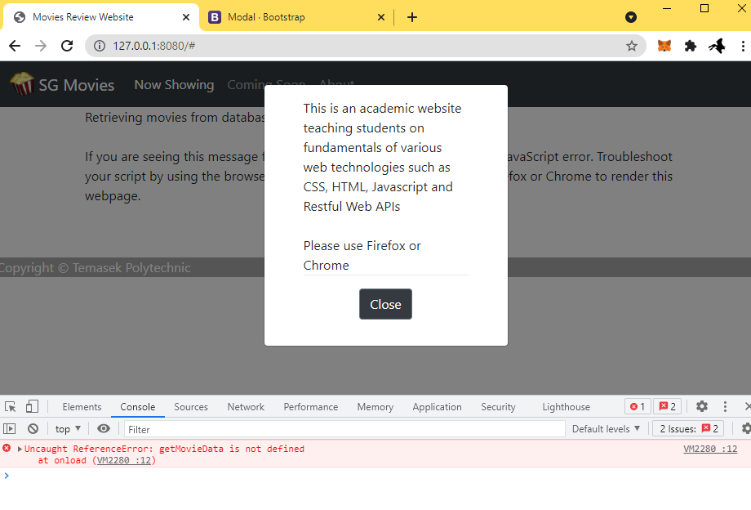
Test the “About” Modal Window
Reload the index.html page in your browser address bar and click on the About menu item. The modal window should appear as shown.

Slide 22
Showing List of Movies – app.js
We’ll now build the javascript codes to show the list of movies.
var movie_url = "/movies";
var movie_array = []; // This creates an empty movie array
var movieCount = 0;
/* There are two categories: "Now Showing" and "Coming Soon". This variable states which
category of movies should be listed when the home page is first loaded. */
var category = "Now Showing";
Declaring some global variables for use in the app

Slide 23
Showing List of Movies – movies.js
//This function is to call the movies api and get all the movies
//that is showing in Shaw Theatres for Showing Now and Coming Soon
function getMovieData() {
var request = new XMLHttpRequest();
request.open('GET', movie_url, true);
//This function will be called when data returns from the web api
request.onload = function() {
//get all the movies records into our movie array
movie_array = JSON.parse(request.responseText);
//Fetch the comments as well
//fetchComments();
console.log(movie_array) // output to console
//call the function so as to display all movies tiles for "Now Showing" displayMovies(category);
};
//This command starts the calling of the movies web api
request.send();}
This code will be uncommented later for the comments feature
Console.log to see if we are successful in getting back the data
This function is to consume the web api endpoint that will return the movies data in json format

Slide 24
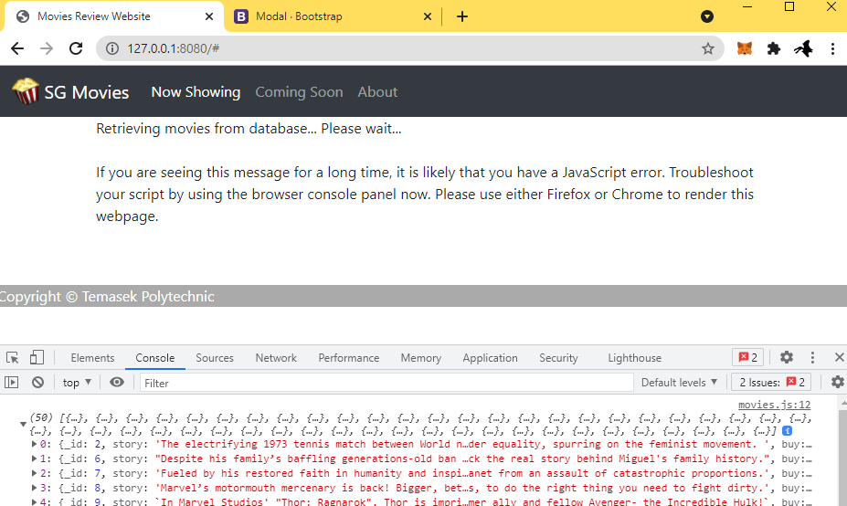
Test the app.js and movies.js
Reload the index.html page in your browser address bar
Output the contents of the movie_array Array

Slide 25
Showing the Movies Posters – movies.js
\ - This is a special character to tell javascript to continue reading the next line as though there is no break. Without this, the formatting will be harder to read
function displayMovies(category) {
var table = document.getElementById("moviesTable");
var movieCount = 0;
var message = "";
table.innerHTML = "";
totalMovies = movie_array.length;
for (var count = 0; count < totalMovies; count++) {
if (movie_array[count].availability == category) {
var thumbnail = movie_array[count].thumb;
var title = movie_array[count].title;
var cell = '<div class="card col-md-3" ><img class="card-img-top" src="' + thumbnail + '" alt="Card image cap">\
<div class="card-body"><i class="far fa-comment fa-lg" style="float:left;cursor:pointer" data-toggle="modal" data-target="#commentModal" item="' + count + '" onClick="showMovieComments(this)"></i>\
<h5 style="padding-left:30px;cursor:pointer" data-toggle="modal" data-target="#movieModal" class="card-title" item="' + count + '" onClick="showMovieDetails(this)">' + title + '</h5></div>\
</div>'
table.insertAdjacentHTML('beforeend', cell);
movieCount++;
}
}
}
This function essentially is to use the movies data and compose new HTML content and display them for the user
Watch the Video explanation for the Iteration here

Slide 26
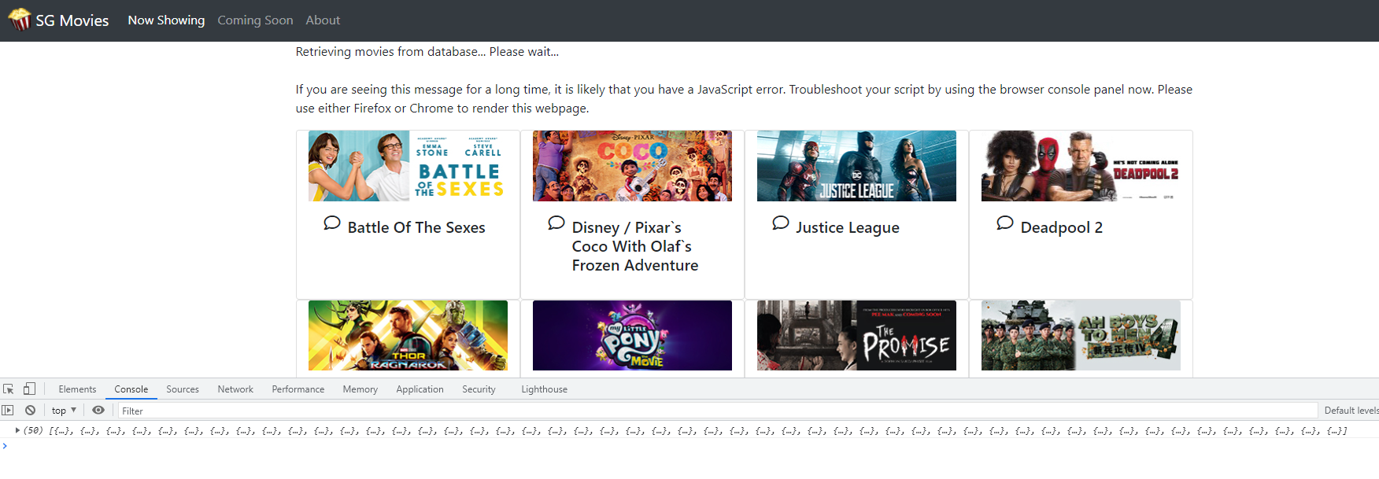
Test the movies.js

Slide 27
Showing the Movies Posters – movies.js
message = movieCount + " Movies " + category;
document.getElementById("summary").textContent = message;
document.getElementById("parent").textContent = "";
Remove the initial message and to display the current category and the number of movies

Slide 28
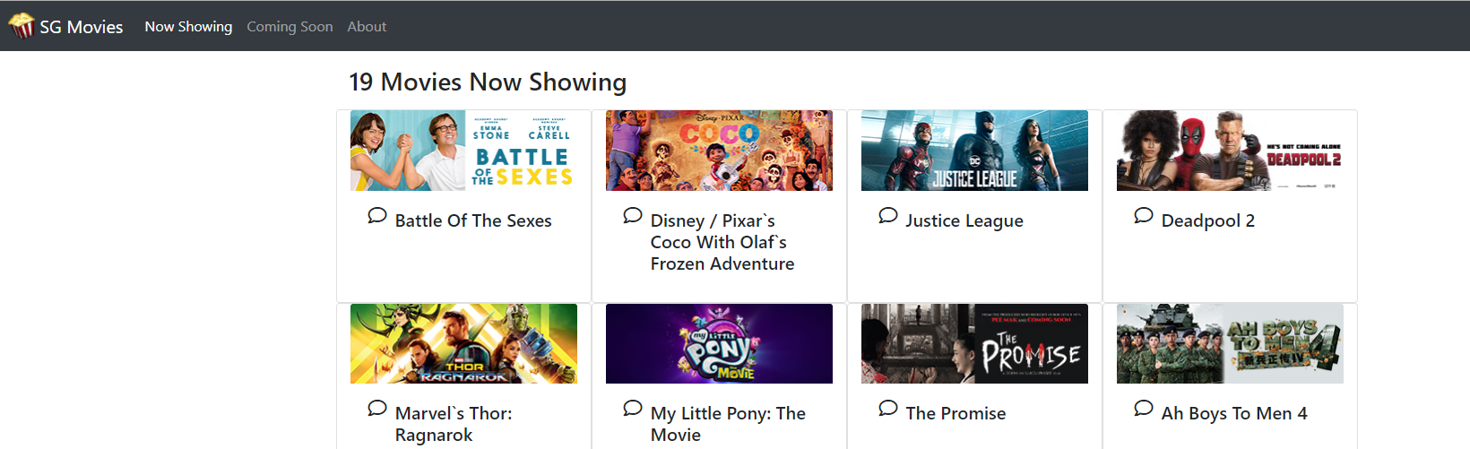
Test the movies.js

Slide 29
Showing the Movies Posters – movies.js
Next, add the codes for the two functions on the right into movies.js.
Remember that the two functions: listNowShowingMovies() and listComingMovies() appeared in the top-navigation.html file for onClick events?
//This function is to display the "Now Showing" movies
function listNowShowingMovies() {
category = "Now Showing";
displayMovies(category);
document.getElementById("nowMenu").classList.add("active");
document.getElementById("comingMenu").classList.remove("active");
document.getElementById("aboutMenu").classList.remove("active");
}
//This function is to display the "Coming Soon" movies
function listComingMovies() {
category = "Coming Soon";
displayMovies(category);
document.getElementById("nowMenu").classList.remove("active");
document.getElementById("comingMenu").classList.add("active");
document.getElementById("aboutMenu").classList.remove("active");
}

Slide 30
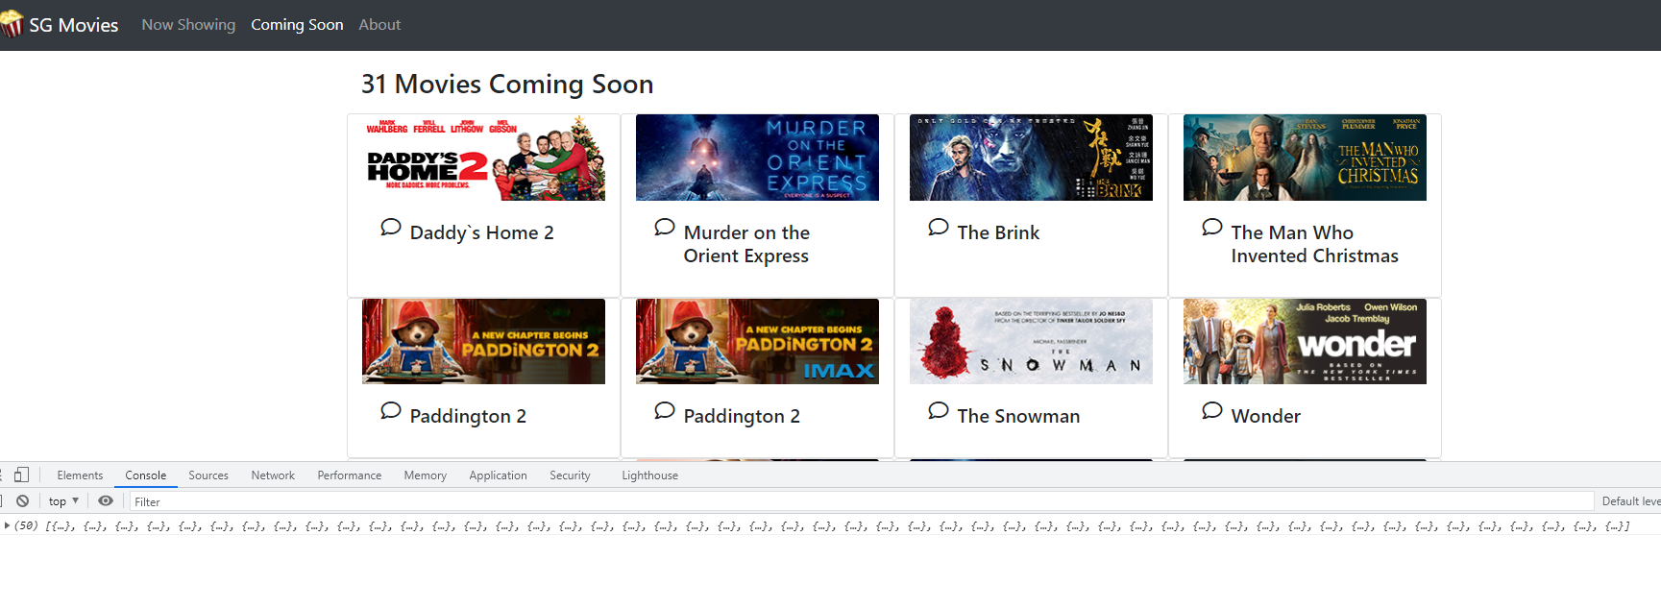
Test the Movies Listing
Reload the index.html page in your browser address bar and the page should appear as shown. Click on “Coming Soon” to see the list of coming movies!

Slide 31
Next Episode…
In the next episode, we will build the modal windows to display movie details and the comments.

Slide 32
The End

